Slide 1


Supervised learning for heartbeat detection in photoplethysmography
Talha Agcayazi
Tanner Songkakul

Slide 2
Background & Motivation
Photoplethysmography (PPG)
Works by interaction of photons with oxygenated and deoxygenated hemoglobin
Heartbeat causes variation of blood volume which can be measured by PPG
Used for many wearable health sensing applications to measure heart rate (HR)
Commercial fitness trackers demonstrate inaccuracy in HR measurement [1]
Low Signal to Noise Ratio
Motion Artifacts
LED
Photodiode

Slide 3
Machine Learning for PPG HR Detection
Our approach: use supervised learning to detect heartbeats from PPG signals (Inspired by Grisan et. Al [2])
Import data from TROIKA Dataset [3]
Preprocess PPG data
Identify ground truth heartbeats from ECG data
Extract features from PPG data
Apply various classifiers to distinguish heartbeat from non-heartbeat
Compare results to CNN
Notes:
Need to establish that we are doing HB vs No HB distinction for HRate

Slide 4
TROIKA Dataset [3]
Contains 2 channels PPG, electrocardiogram (ECG), and accelerometer data from 12 patients, all sampled at 125 Hz
Walked or ran on a treadmill at speeds of 1–2 km/h, 6–8 km/h, and 12–15 km/h,
Encouraged to pull clothes, wipe sweat on forehead, and push buttons on the treadmill.
PPG and ECG Data for one patient, full trial
PPG and ECG Data for one patient, 10 sec window

Slide 5
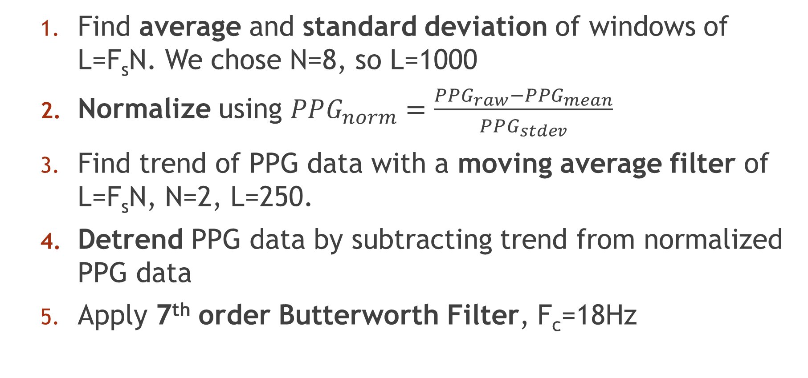
Preprocessing PPG Signal
Find average and standard deviation of windows of L=F_{s}N. We chose N=8, so L=1000
Normalize using $PPG_{norm}=\frac{PPG_{raw}−PPG_{mean}}{PPG_{stdev}}$
Find trend of PPG data with a moving average filter of L=F_{s}N, N=2, L=250.
Detrend PPG data by subtracting trend from normalized PPG data
Apply 7th order Butterworth Filter, F_{c}=18Hz

Slide 6
Preprocessing Results

Slide 7
Ground Truth Extraction- Peak Detection
Used Pan-Tompkins Algorithm to extract peak locations from ECG data

Slide 8
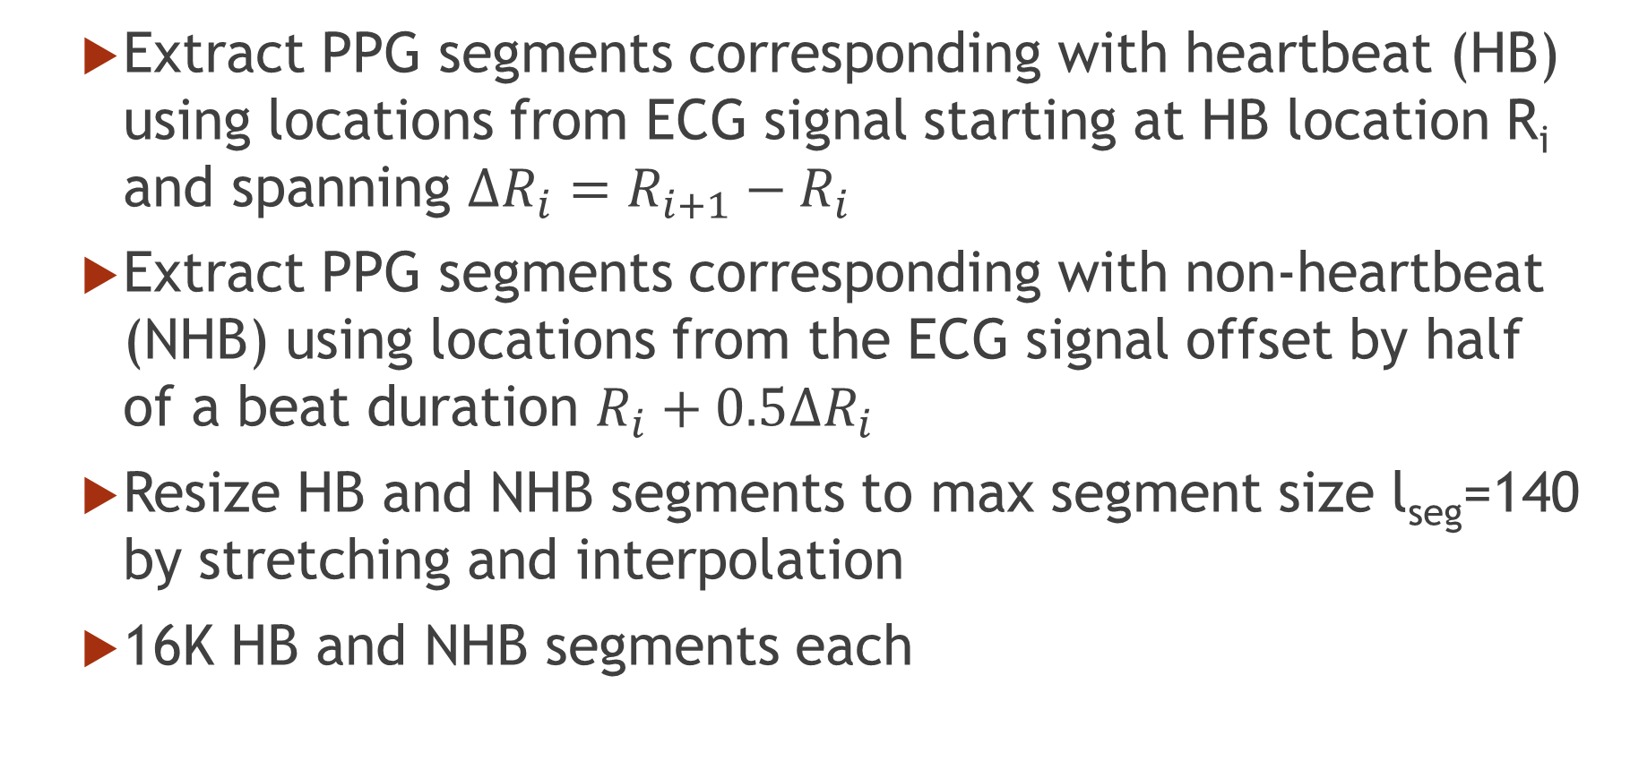
Ground Truth Extraction- HB vs NHB Segmentation
Extract PPG segments corresponding with heartbeat (HB) using locations from ECG signal starting at HB location R_{i} and spanning $ΔR_{i}=R_{i+1}−R_{i}$
Extract PPG segments corresponding with non-heartbeat (NHB) using locations from the ECG signal offset by half of a beat duration $R_{i}+0.5ΔR_{i}$
Resize HB and NHB segments to max segment size l_{seg}=140 by stretching and interpolation
16K HB and NHB segments each

Slide 9
Ground Truth Extraction- Results
HB Segments
NHB Segments
ECG
PPG
Samples
Samples

Slide 10
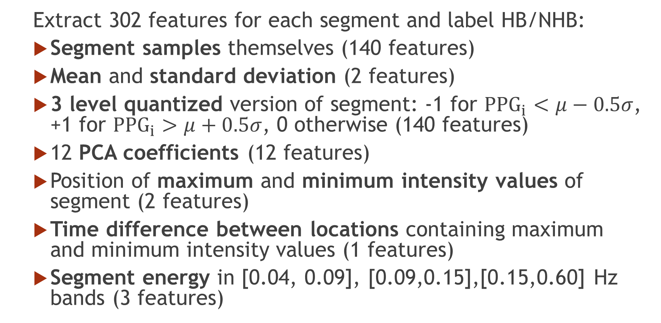
Feature Extraction
Extract 302 features for each segment and label HB/NHB:
Segment samples themselves (140 features)
Mean and standard deviation (2 features)
3 level quantized version of segment: -1 for ${PPG}_{i}<μ−0.5σ$, +1 for ${PPG}_{i}>μ+0.5σ$, 0 otherwise (140 features)
12 PCA coefficients (12 features)
Position of maximum and minimum intensity values of segment (2 features)
Time difference between locations containing maximum and minimum intensity values (1 features)
Segment energy in [0.04, 0.09], [0.09,0.15],[0.15,0.60] Hz bands (3 features)

Slide 11
Machine Learning Techniques
Conventional Techniques
Linear Discriminant
K-Nearest Neighbors (K-NN)
Decision Tree
Support Vector Machine (SVM)
Convolutional Neural Network
Convolutional Neural Networks (CNN)

Slide 12
Conventional Classification Results
Implemented with Matlab’s Classification Learner App
5-fold validation
Used all 302 features
Classifier | Accuracy
Linear Discriminant | 80.6%
1-NN | 81.1%
5-NN | 83.5%
Decision Tree | 80.5%
Linear SVM | 79.2%
Cubic SVM | 84.5%

Slide 13
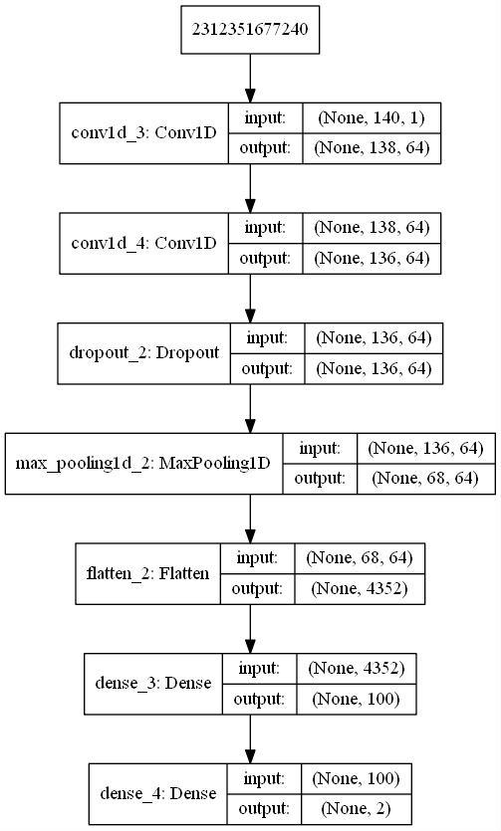
Convolutional Neural Network Structure
140x1
Input: Segment samples only
Kernel: 3x1
Activation: Relu
Dropout: 0.5
Pool Size: 2
Output: 2 classes (softmax)

Slide 14
CNN Results
Classifier | Accuracy
Cubic SVM (302 features) | 84.5%
CNN (No features) | 86.6%

Slide 15
Conclusions
Preprocessing, ground truth extraction, and future extraction from PPG and ECG signals
Compared conventional and neural network classifiers
Achieved a peak performance of 86% correct heartbeat identification without any feature engineering

Slide 16
Future Work
Try a variety of hyperparameters for CNN
Incorporate more PPG/ECG data
Incorporate accelerometer data for adaptive filtering
Perform PCA on all features and remove some of the unnecessary ones
Try extra features like: wavelet and coefficient of skewness
Incorporate classification results into real time systems for physiological health monitoring

Slide 17
Sources
[1] S. Benedetto, C. Caldato, E. Bazzan, D. C. Greenwood, V. Pensabene, and P. Actis, “Assessment of the Fitbit Charge 2 for monitoring heart rate,” PLoS One, vol. 13, no. 2, pp. 1–11, 2018.
[2] E. Grisan, G. Cantisani, G. Tarroni, S. K. Yoon and M. Rossi, “A supervised learning approach for the robust detection of heart beat in plethysmographic data”; 2015 37th Annual International Conference of the IEEE Engineering in Medicine and Biology Society (EMBC), Milan, 2015, pp. 5825-5828.
[3] S. Zhu, K. Tan, X. Zhang, Z. Liu, and B. Liu, “TROIKA: A mixed approach for heart rate monitoring during intensive physical exercise using wrist-type PPG Signals,” Proc. Annu. Int. Conf. IEEE Eng. Med. Biol. Soc. EMBS, vol. 2015–Novem, no. 2, pp. 2347– 2350, 2015.

